Slide 1
What are Triggers in PL/SQL?
3
🠶Triggers are stored programs that are fired automatically when some events occur. The code to be fired can be defined as per the requirement.
🠶Oracle has also provided the facility to mention the event upon which the trigger needs to be fire and the timing of the execution.

Slide 2
Types of Triggers in Oracle
4
🠶 Triggers can be classified based on the following parameters.
🠶 Classification based on the timing
🠶 BEFORE Trigger: It fires before the specified event has occurred.
🠶 AFTER Trigger: It fires after the specified event has occurred.
🠶 Classification based on the level
🠶 STATEMENT level Trigger: It fires one time for the specified event statement.
🠶 ROW level Trigger: It fires for each record that got affected in the specified event. (only for DML)
🠶 Classification based on the Event
🠶 DML Trigger: It fires when the DML event is specified (INSERT/UPDATE/DELETE)
🠶 DDL Trigger: It fires when the DDL event is specified (CREATE/ALTER)
🠶 DATABASE Trigger: It fires when the database event is specified
(LOGON/LOGOFF/STARTUP/SHUTDOWN)
🠶 So each trigger is the combination of above parameters.

Slide 3
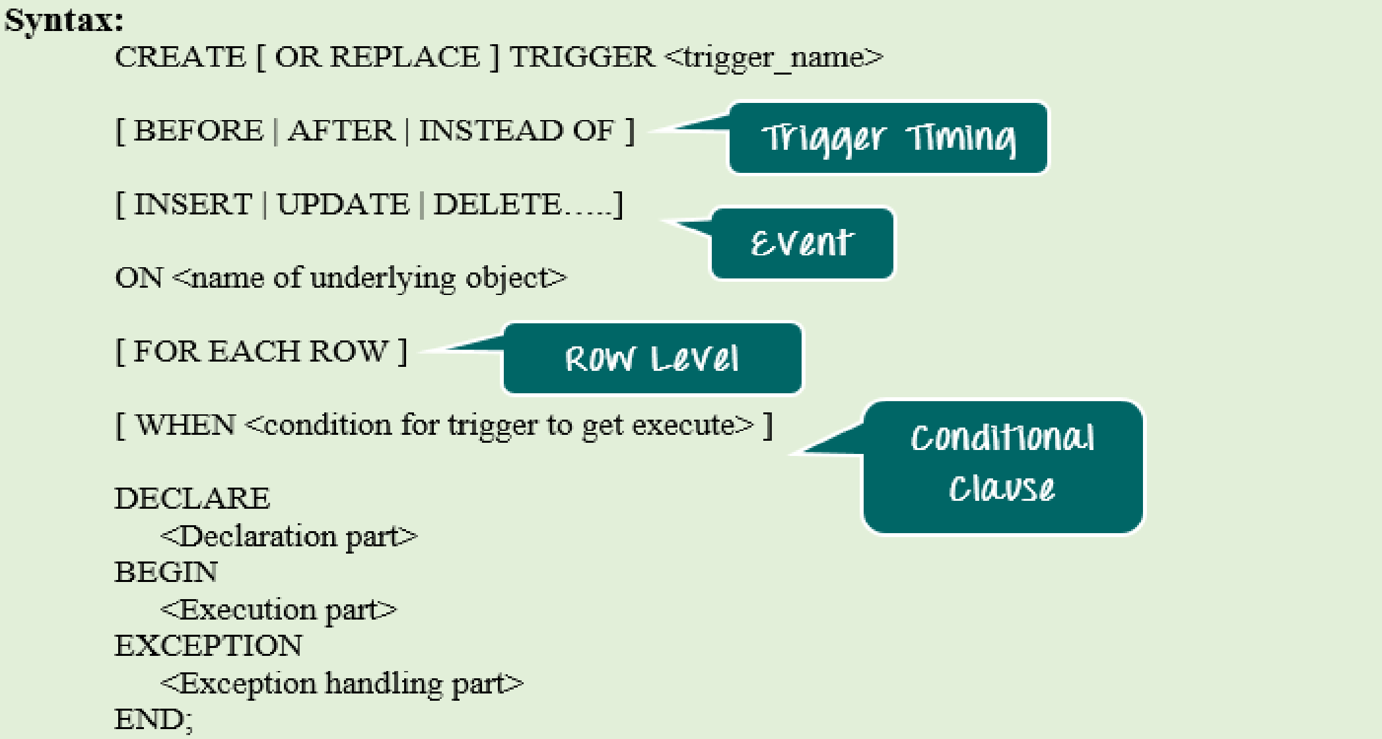
How to Create Trigger
5
🠶 Below is the syntax for creating a trigger.
JAIN UNIVERSITY BCA

Slide 4
7
EXAMPLE-2: Create a trigger to insert a new record to log table after inserting a record to dept table
Create or replace trigger depttrig AFTER INSERT ON dept
FOR EACH ROW BEGIN
INSERT INTO dept_log VALUES(:new.deptno,:new.dname,:new.loc); END;
EXAMPLE-3: Create a trigger to insert aold record to log table after updating or deleting a record to
dept table
Create or replace trigger dept_trig BEFORE update or delete on dept FOR EACH ROW
BEGIN
INSERT INTO dept_log VALUES(:old.deptno,:old.dname,:old.loc); END;
JAIN UNIVERSITY BCA

Slide 5
Dictionary for triggers is user_triggers
10
SQL>Select trigger_name,trigger_body,table_name,description
from user_triggers
Enabling/Diasabling Triggers
To enable a disabled trigger, use the ALTER TRIGGER statement with the ENABLE clause.
Example:
SQL>ALTER TRIGGER trig_error ENABLE;
To enable all triggers defined for a specific table, use the ALTER TABLE statement with the ENABLE clause and the ALL TRIGGERS option.
SQL>ALTER TABLE emp ENABLE ALL TRIGGERS;

Slide 6
Disabling Triggers
11
🠶You might temporarily disable a trigger if:
🠶You must perform a large data load, and you want it to proceed quickly without firing triggers.
🠶ALTER TRIGGER trig_error DISABLE;
🠶To disable all triggers defined for a specific table, use the ALTER TABLE statement with the DISABLE clause and the ALL TRIGGERS option. For example, to disable all triggers defined for the Inventory table, enter the following statement:
🠶ALTER TABLE emp DISABLE ALL TRIGGERS;

